Slide 1
FUNDAMENTALS -
DOCKER
(Containers)
LECTURE I
Jose Luis Gómez Ortega
MDA - MIA
2024
Notes:
<número>

Slide 2


HELLO!
JOSE LUIS GOMEZ ORTEGA
- PhD Computer Science
- Msc Engineering with Management
- Diplomatura Ingenieria Industrial
Currently:
Data Science Lead instructor @ TheBridge/EDEM
https://www.linkedin.com/in/jlgortega/
jose.lgo.datascience@gmail.com

Slide 3

QUICK ROUND?

Slide 4
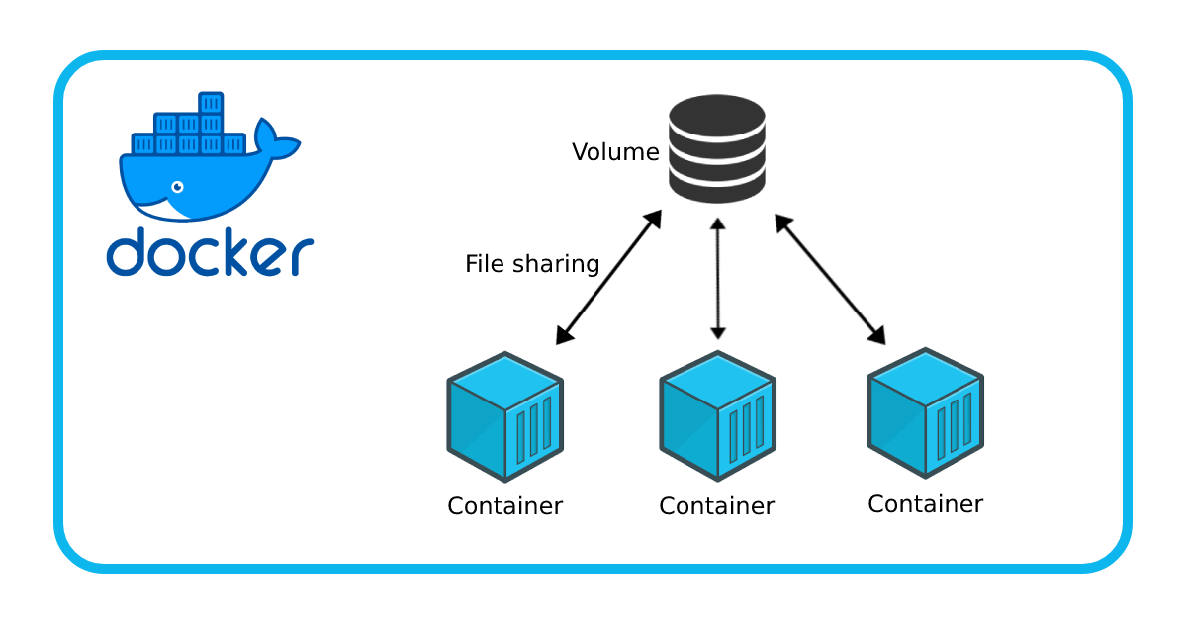
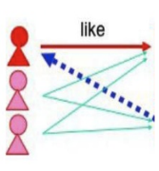


Introduction to Docker: Foundations and Concepts
Setting the Stage for Containerization
Welcome to the Docker Introduction Session

Slide 5
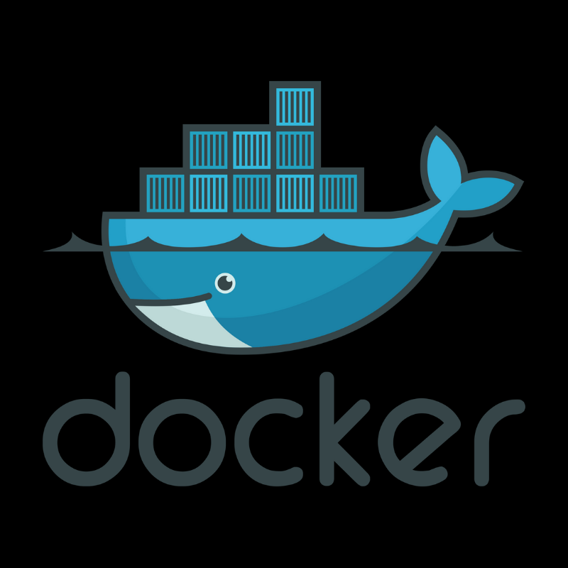
AGENDA
Services and Ports in Operating Systems
DevOps Principles
Modern Application Architectures
Virtual Machines and Hypervisors
Virtualization in the Cloud
Introduction to Docker
TOPICS:

Slide 6
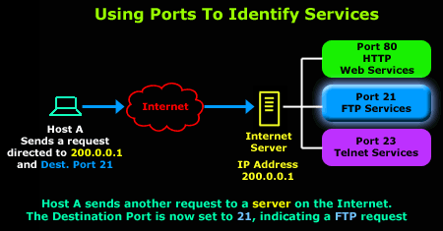
Services
Definition: Programs running in the background, providing functionalities to other software or users.
Examples: Web servers, database servers, email servers.
Understanding Services in Operating Systems:

Slide 7
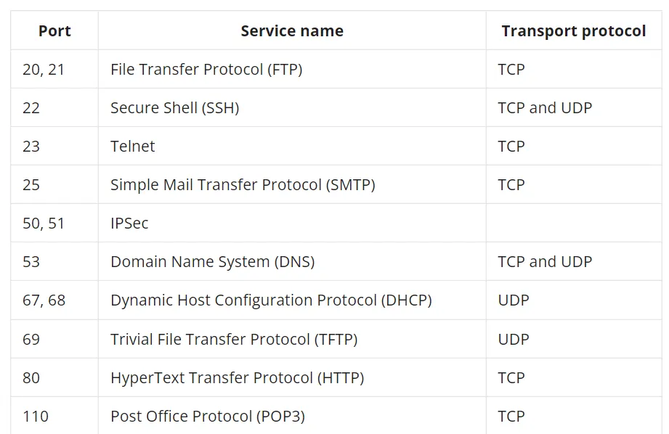
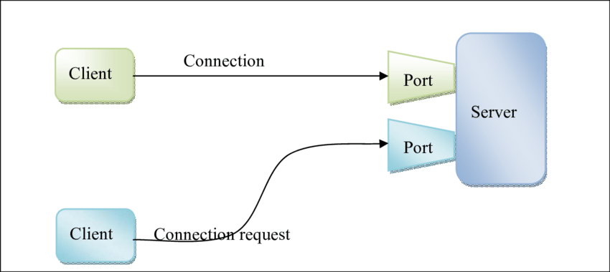
Definition: Logical endpoints for network communication, identifying specific processes or services.
Port Numbers: Range from 0 to 65535.
Ports
The Role of Ports in Networking

Slide 8
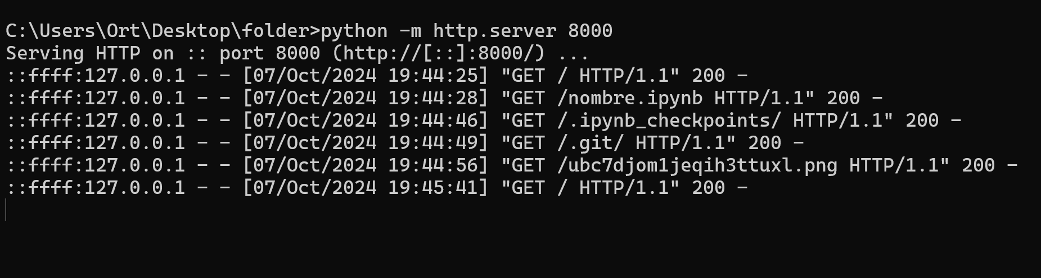
Services AND Ports
Service Binding: Services "listen" on specific ports for incoming requests.
Client Communication: Clients connect using the service's port number.

Slide 9
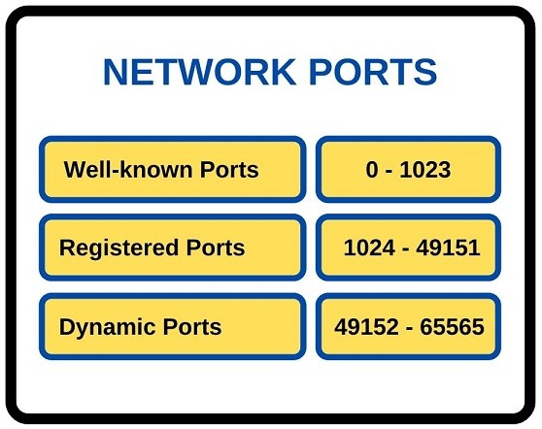
Port RANGE I
Puertos Bien Conocidos (Well-Known Ports): 0 - 1023
Estos puertos están reservados para servicios y aplicaciones que son ampliamente utilizados y estandarizados a nivel mundial.
Son asignados y administrados por la IANA (Internet Assigned Numbers Authority).
Requieren privilegios administrativos para ser utilizados en muchos sistemas operativos.
Están asociados a servicios fundamentales de Internet
Puerto 53: DNS (Domain Name System)
Puerto 80: HTTP (HyperText Transfer Protocol)
Puerto 110: POP3 (Post Office Protocol v3)
Puerto 143: IMAP (Internet Message Access Protocol)
Puerto 443: HTTPS (HTTP Secure)

Slide 10
Port RANGE II
Puertos Registrados (Registered Ports): 1024 - 49151
Estos puertos son asignados por la IANA a aplicaciones y servicios específicos para evitar conflictos.
No son tan estandarizados como los puertos bien conocidos, pero permiten identificar aplicaciones comunes.
Generalmente no requieren privilegios administrativos para su uso.
Son utilizados por aplicaciones de usuario o servicios que necesitan un puerto fijo.
Puerto 1433: Microsoft SQL Server
Puerto 1521: Oracle Database
Puerto 3306: MySQL
Puerto 5432: PostgreSQL
Puerto 6379: Redis
Puerto 8080: Servidores web alternativos o en desarrollo
Puerto 27017: MongoDB

Slide 11
Port RANGE IiI
Puertos Dinámicos o Privados (Dynamic or Private Ports): 49152 - 65535
Estos puertos no están asignados a ningún servicio o aplicación específica.
Son utilizados temporalmente por aplicaciones para establecer conexiones efímeras.
Asignados dinámicamente por el sistema operativo cuando una aplicación necesita comunicarse en red.
No requieren registro ni administración por parte de la IANA.
Puertos Efímeros: Cuando un cliente inicia una conexión a un servidor (por ejemplo, al navegar por Internet), el sistema operativo asigna un puerto dinámico para esa sesión.
Aplicaciones Peer-to-Peer: Pueden utilizar puertos dinámicos para establecer conexiones directas entre usuarios.

Slide 12

EXERCISE
EXAMPLE – PYTHON SERVER

Slide 13
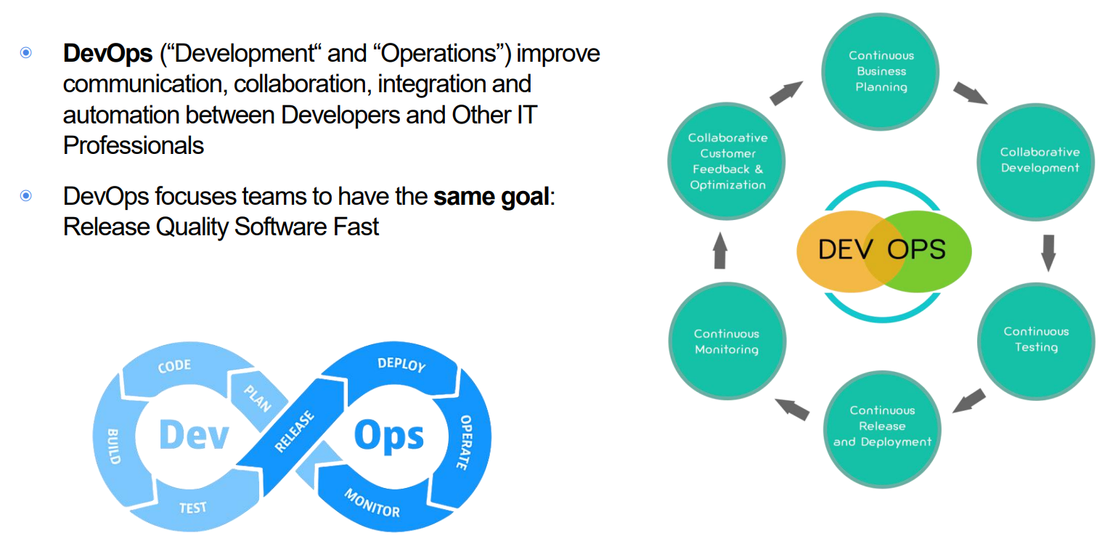
DEVOPS

Slide 14
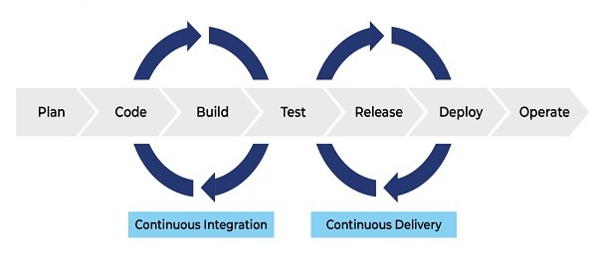
KEY DEVOP PRACTICES
Continuous Integration (CI): Frequent code integrations into a shared repository.
Continuous Delivery (CD): Automating the software release process.
Infrastructure as Code (IaC): Managing and provisioning infrastructure through code rather than manual processes.

Slide 15
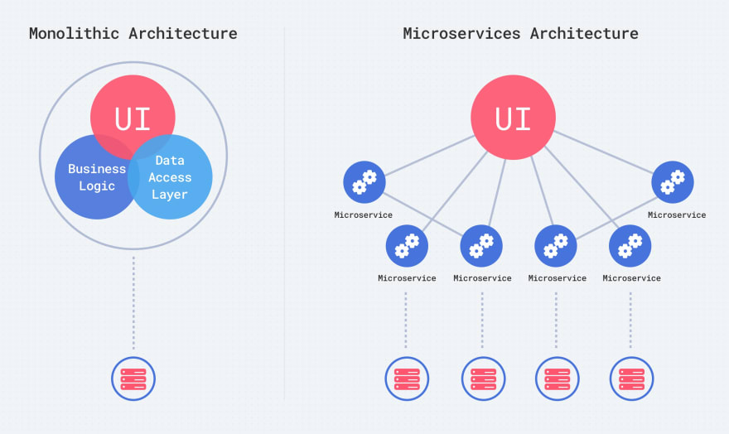
MONOLITHIC/MICROSERVICES

Slide 16
MONOLITHIC/MICROSERVICES
◉ Everything from user interface, business
codes and database calls is included in the same
codebase.
◉ All application concerns are contained in a single
big deployment
◉ Disadvantages:
Difficult to scale
Difficult to test
Difficult to evolve and add new feature

Slide 17
MONOLITHIC/MICROSERVICES
◉ Microservices are an architectural style that structures an application as a collection of services that are:
○ Highly maintainable and testable
○ Loosely Coupled
○ Independently deployable
○ Organized around business capabilities
○ Owned by a small team
◉ The microservice architecture enables the rapid, frequent and reliable delivery of large, complex applications.

Slide 18
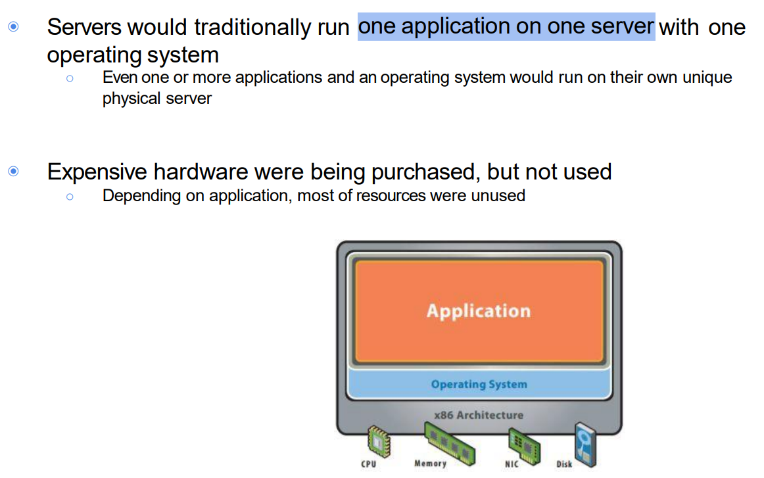
VIRTUALIZATION
Before
Virtualization

Slide 19
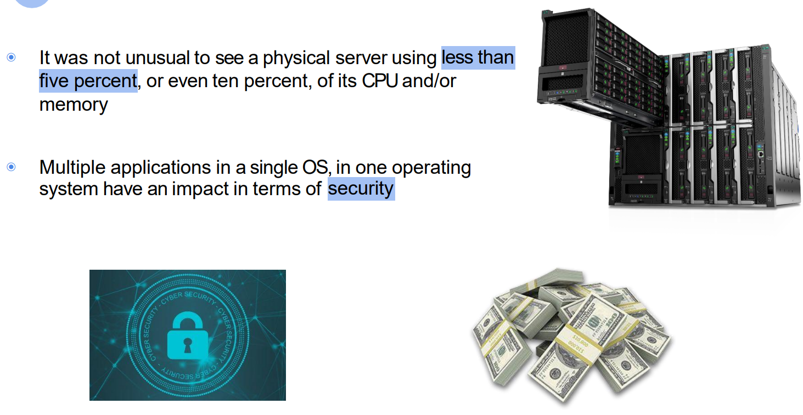
VIRTUALIZATION
Before
Virtualization

Slide 20
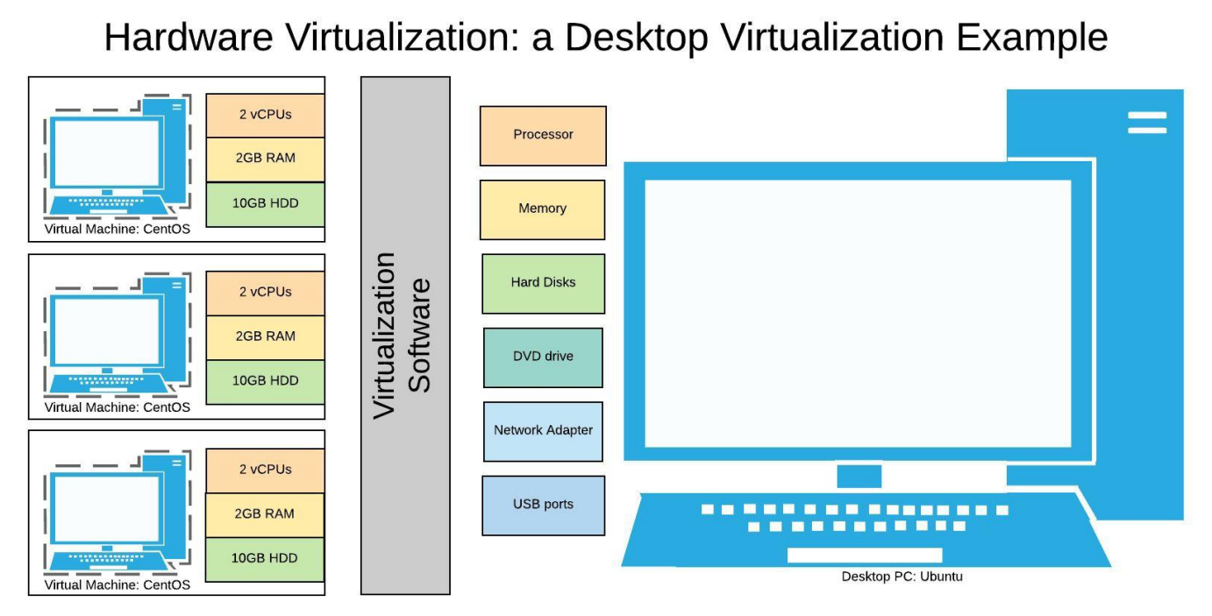
What is virtualization

Slide 21
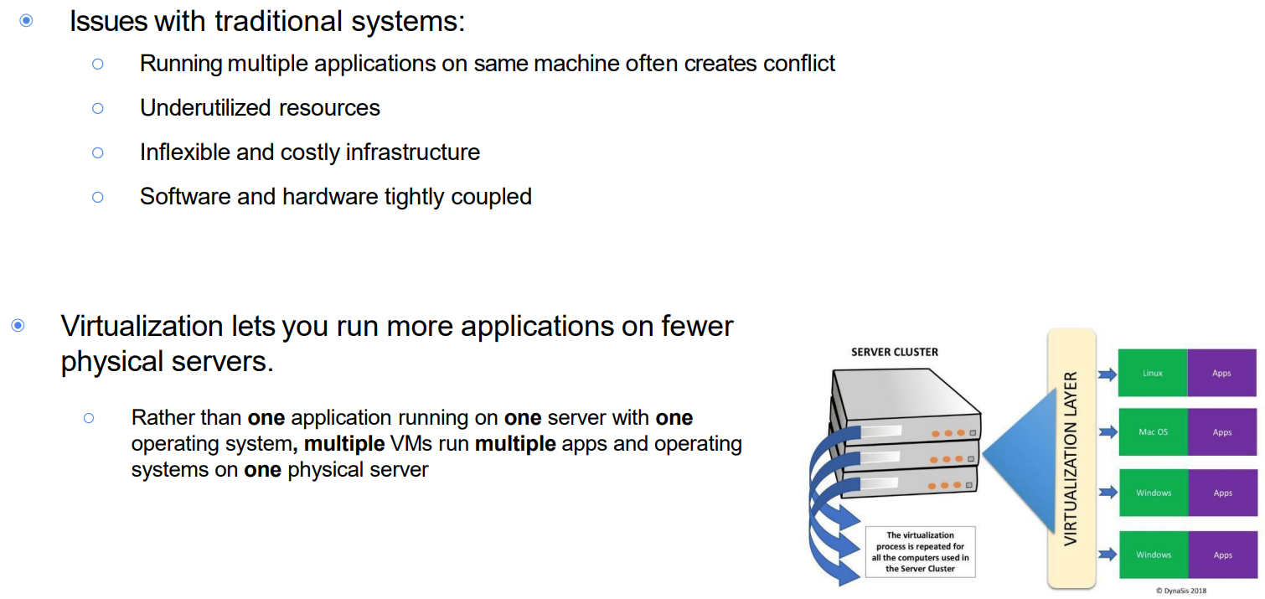
WHY virtualization

Slide 22
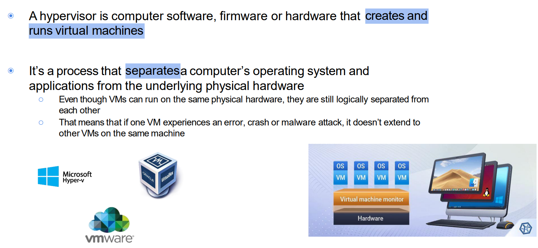
HYPERVISOR

Slide 23
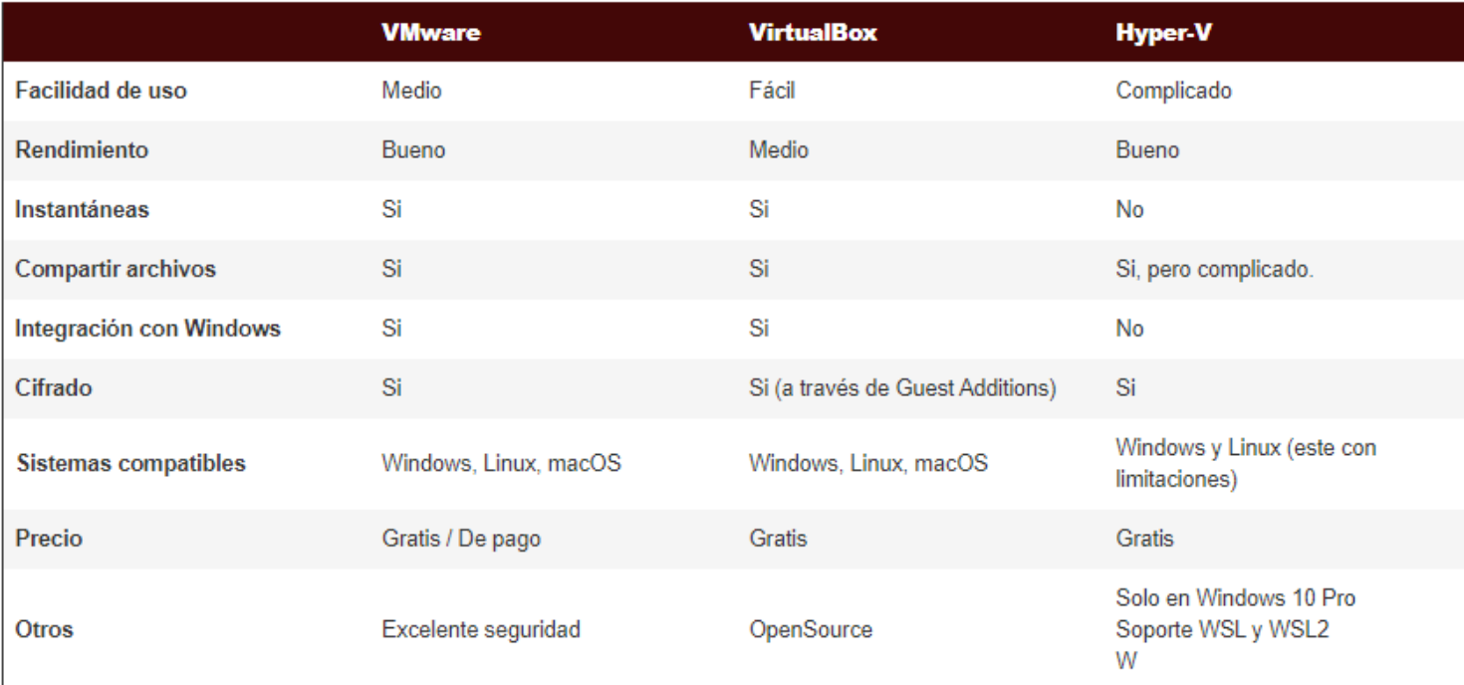
HYPERVISOR

Slide 24
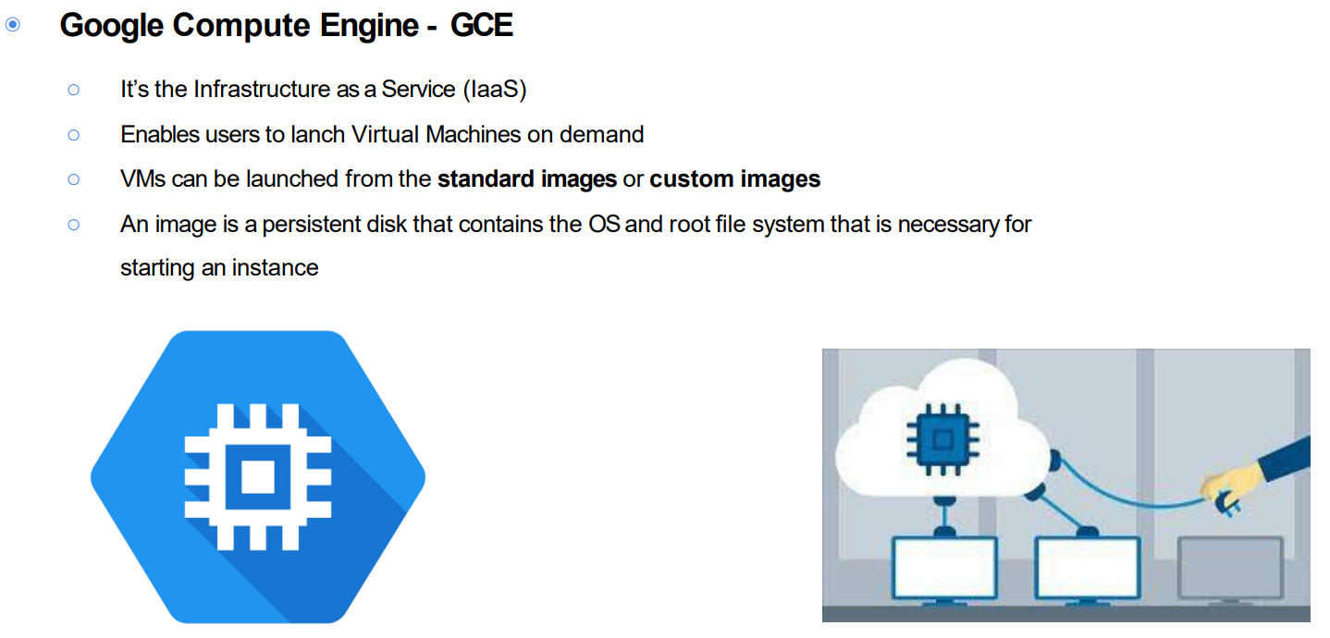
VIRTUALIZATION GCP

Slide 25
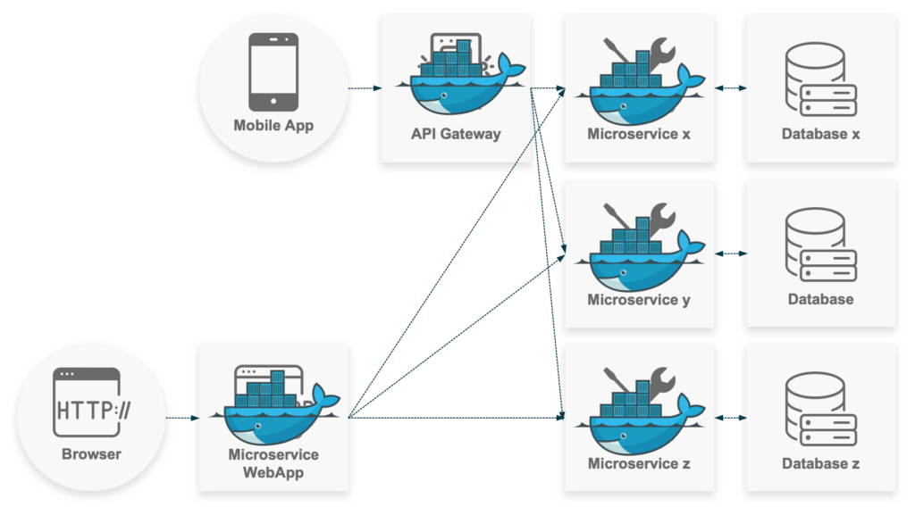
Recap and key takeaways
Services and Ports:
Foundation of network communication.
DevOps:
Enhancing collaboration and efficiency.
Application Architectures:
Transition from monolithic to microservices.
Virtualization:
Enabling flexible and efficient resource use.
Preparing for Docker:
Understanding the need for containerization.

Slide 26
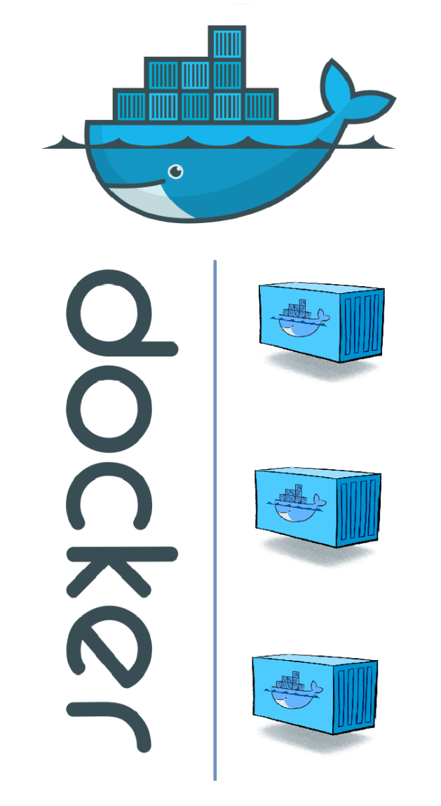
DIVING INTO DOCKER
Why Docker?:
Solves many limitations of VMs.
Simplifies deployment and scaling.
Docker in DevOps:
Integral to modern CI/CD pipelines.
What's Ahead:
Installing Docker.
Running your first container..

Slide 27
THANKS!
JOSE LUIS GOMEZ ORTEGA
jose.lgo.datascience@gmail.com

